Slide 1
Distant Metastasis-Free Survival Results From the Randomized, Phase 2 mRNA-4157-P201/ KEYNOTE-942 Trial
Adnan Khattak,^{1,2} Jeffrey S. Weber,³ Tarek Meniawy,⁴ Matthew H. Taylor,⁵ George Ansstas,⁶ Kevin B. Kim,⁷ Meredith McKean,⁸ Georgina V. Long,⁹ Ryan J. Sullivan,¹⁰ Mark B. Faries,¹¹ Thuy Tran,¹² C. Lance Cowey,¹³ Theresa M. Medina,¹⁴ Jennifer M. Segar,¹⁵ Victoria Atkinson,¹⁶ Geoffrey T. Gibney,¹⁷ Jason J. Luke,¹⁸ Elizabeth I. Buchbinder,¹⁹ Robert S. Meehan,²⁰ Matteo S. Carlino,^{9,21} Moderna Author's Group²⁰
¹Hollywood Private Hospital, Nedlands, Australia; ²Edith Cowan University, Perth, Australia; ³NYU Langone Medical Center, New York, NY; ⁴Saint John of God Subiaco Hospital, Subiaco, Australia; ⁵Earle A. Chiles Research Institute, Portland, OR, USA; ⁶Washington University School of Medicine, St Louis, MO, USA; ⁷California Pacific Medical Center Research Institute, Oakland, CA, USA; ⁸Sarah Cannon Research Institute, Nashville, TN, USA; ⁹Melanoma Institute Australia, Wollstonecraft, Australia; ¹⁰Massachusetts General Hospital, Boston, MA, USA; ¹¹The Angeles Clinic and Research Institute, Los Angeles, CA, USA; ¹²Yale-New Haven Hospital, New Haven, CT, USA; ¹³Baylor Charles A. Sammons Cancer Center, Dallas, TX, USA; ¹⁴University of Colorado, Aurora, CO, USA; ¹⁵The University of Arizona Cancer Center, Tucson, AZ, USA; ¹⁶Princess Alexandra Hospital, Woolloongabba, Australia; ¹⁷Lombardi Cancer Center, Washington, DC, USA; ¹⁸UPMC Hillman Cancer Center, Pittsburg, PA, USA; ¹⁹Dana-Farber Cancer Institute, Boston, MA, USA; ²⁰Moderna Inc., Cambridge, MA, USA; ²¹Westmead Hospital, Westmead, Australia.
Sponsored by Moderna, Inc., in collaboration with Merck Sharp & Dohme LLC, a subsidiary of Merck & Co., Inc., Rahway, NJ, USA.
Adnan Khattak, MBBS, FRACP, PhD

Slide 2
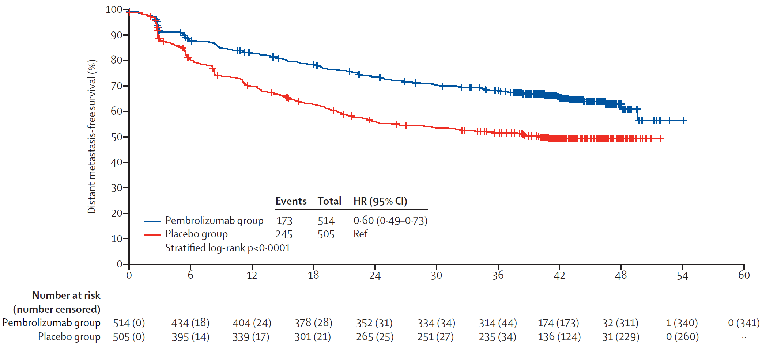
Adjuvant ICI Therapy and DMFS in High-risk Melanoma
Both RFS and DMFS have been evaluated as surrogates for overall survival. DMFS captures patients whose relapse is associated with a worse prognosis and who may need further systemic treatment¹
The KEYNOTE-054 study showed that the 3.5-year DMFS was significantly higher for patients receiving pembrolizumab (65.3%) versus placebo (49.4%) in the ITT population (P <0.0001)²
These analyses suggest an unmet clinical need with high metastasis rates even with effective adjuvant melanoma therapy
mRNA-4157 (V940) + pembrolizumab significantly improved RFS versus pembrolizumab monotherapy (HR = 0.561 [95% CI, 0.309,1.017; P = 0.0266]³
Here, we report the first DMFS results from the mRNA-4157-P201/KEYNOTE-942 study
KEYNOTE-054: DMFS
Reprinted from Lancet Oncology, Volume No. 22, Eggermont AMM, et al, Adjuvant pembrolizumab versus placebo in resected stage III melanoma (EORTC 1325-MG/KEYNOTE-054): distant metastasis-free survival results from a double-blind, randomised, controlled, phase 3 trial, Pages No. 643–654, Copyright 2021, with permission from Elsevier.
1. Amabile S, et al. J Clin Med. 2021;10:5475. 2. Eggermont AMM, et al. Lancet Oncol. 2021.22:643-654. 3. Khattak A, et al. Presented at the American Association for Cancer Research® (AACR) Annual Meeting; April 14-19, 2023; Orlando, FL, USA. Oral presentation CT001.
Adnan Khattak, MBBS, FRACP, PhD
Notes:
Durable Benefit From Checkpoint Inhibitors Suggests Long-term Efficacy Against Microscopic Disease and Detectable Metastases¹

Slide 3
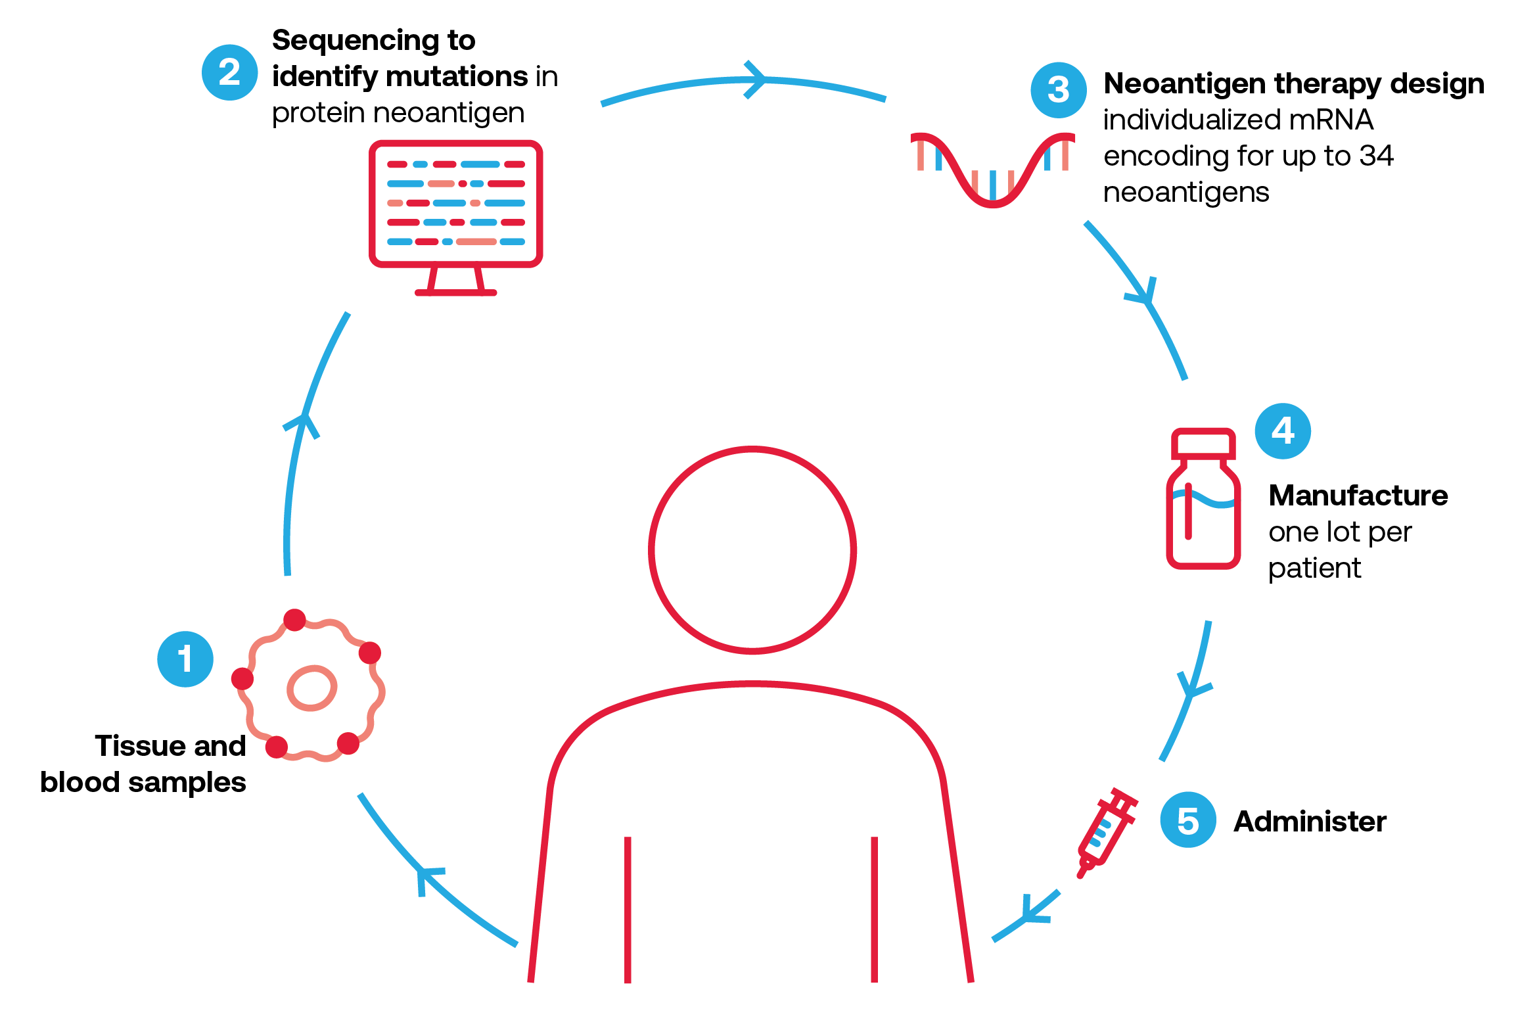
mRNA-4157 (V940) Mechanism of Action
mRNA-4157 (V940) is an individualized neoantigen therapy designed to target an individual patient’s unique tumor mutations and encodes up to 34 neoantigens^{1,2}
Therapies targeting neoantigens can increase endogenous neoantigen T-cell responses and induce epitope spreading to novel antigens with the ability to drive antitumor responses and maintain memory with cytolytic properties, potentially producing long-term disease control for patients³⁻⁷
~6 weeks
HLA, human leukocyte antigen; INT, individualized neoantigen therapy; ORF, open reading frame. 1. Burris HA, et al. J Clin Oncol. 2019;37(suppl 15). Abstract 2523. 2. Zhong S, et al. Cancer Res. 80(suppl 16). Abstract 6539. 3. Wirth TC, Kühnel F. Front Immunol. 2017;8:1848. 4. Ott PA, et al. Nature. 2017;547:217-221. 5. Hu Z, et al. Nat Med. 2021;27:515-525. 6. Ott PA, et al. Cell. 2020;183:347-362. 7. Palmer CD, et al. Nat Med. 2022;28:1619-1629.
Adnan Khattak, MBBS, FRACP, PhD

Slide 4
mRNA-4157-P201/KEYNOTE-942 (NCT03897881) Study Design
Randomized, phase 2, open-label study in adjuvant resected melanoma patients at high risk of recurrence
Combination treatment arm: mRNA-4157 (V940) + pembrolizumab
Up to 1 year of pembrolizumab treatment
mRNA-4157 (V940) 1 mg IM Q3W for up to 9 doses + pembrolizumab 200 mg IV Q3W for up to 18 cycles
(n = 107)
Primary endpoint: RFS^{c,d}
Secondary endpoints: DMFS,^{e}
safety, tolerability
Follow-up:
up to 3 years following the first dose of pembrolizumab
Key eligibility criteria
Resected stage IIIB,ª IIIC, IIID, or IV cutaneous melanoma
Complete surgical resection within 13 weeks prior to first pembrolizumab dose
Disease-free at study entry
ECOG PS score 0-1
Tissue available for NGS
2:1 Randomization
Stratified by disease stage^{b}
Control treatment arm: pembrolizumab monotherapy
Up to 1 year of pembrolizumab treatment
pembrolizumab 200 mg IV Q3W for up to 18 cycles
(n = 50)
Designed with 80% power to detect an HR of 0.5 with ≥40 RFS events (with a 1-sided alpha of 0.1)
DMFS analysis was prespecified for testing following positive RFS in the ITT population^{f}
Median follow-up^{g}: 23 months for mRNA-4157 (V940) + pembrolizumab 24 months for pembrolizumab monotherapy
ªPatients with stage IIIB disease were eligible only if relapse occurred within 3 months of prior surgery of curative intent. ^{b}According to the 8th edition of the American Joint Committee on Cancer Staging Manual. ^{c}The primary endpoint was investigator-assessed RFS (defined as the time from first dose of pembrolizumab until the date of first recurrence [local, regional, or distant metastasis], a new primary melanoma, or death from any cause) in the intention-to-treat population. ^{d}The primary analysis for RFS was specified to occur after all patients completed ≥12 months on study and ≥40 RFS events were observed. Descriptive analysis was specified to occur when ≥51 RFS events were observed. ^{e}Investigator-assessed DMFS was defined as the time from first dose of pembrolizumab until the date of first distant recurrence or death from any cause. ^{f}The stratified log-rank test was used for comparison. ^{g}Time of database cutoff was November 14, 2022.
Adnan Khattak, MBBS, FRACP, PhD

Slide 5
mRNA-4157-P201/KEYNOTE-942 Patient Demographics
Characteristic, n (%) | mRNA-4157 (V940) + pembro (n = 107) | Pembro (n = 50)
Sex
Male Female | 70 (65.4) 37 (34.6) | 31 (62.0) 19 (38.0)
Age, years
Mean (SD) Range (median) | 61.3 (13.50) 63 (26-83) | 59.4 (14.25) 61.5 (24-89)
Age group
<65 years ≥65 years | 59 (55.1) 48 (44.9) | 28 (56.0) 22 (44.0)
ECOG PS scoreª
0 1 | 90 (84.1) 15 (14.0) | 40 (80.0) 9 (18.0)
Stage^{b}
Stage IIIC Stage IIID Stage IV | 89 (83.2) 2 (1.9) 16 (15.0) | 42 (84.0) 2 (4.0) 6 (12.0)
LDH, U/L
Median (range) >ULN | 189.5 (118-528) 5 (4.7) | 185.5 (113-1180) 3 (6.0)
Lymph node dissection | 34 (31.8) | 15 (30.0)
PD-L1 status
Positive Negative Indeterminant^{c} | 69 (64.5) 13 (12.1) 25 (23.4) | 27 (54.0) 5 (10.0) 18 (36.0)
BRAF^{d}
V600K or V600E mutation WT^{e} | 41 (38.3) 66 (61.7) | 20 (40.0) 30 (60.0)
Tumor mutational burden^{f}
<10 mutations/Mb ≥10 mutations/Mb | 26 (24.3) 79 (73.8) | 19 (38.0) 30 (60.0)
ªThree patients were not treated and therefore, had no baseline ECOG PS. ^{b}According to the 8th edition of the American Joint Committee on Cancer staging manual. ^{c}Patients for whom there was no sample to send for PD-L1 evaluation or for whom sample quality or quantity was too low to perform the assay. ^{d}BRAF status determined by WES on baseline tumor samples. ^{e}WT refers to position 600 on BRAF gene. ^{f}Available for 154 patients. WES, whole exome sequencing; WT, wild type.
Adnan Khattak, MBBS, FRACP, PhD

Slide 6
Primary Efficacy Endpoint: RFS¹
+
+
12-month RFS
18-month RFS
+
+
+
83.4%
+
+
78.6%
+ Censored
+
+
+
+
+
+
+
+
+
+
+
+
+
+
+
+
+
+
+
+
+
+
+
+
+
+
+
+
+
+
+
+
+
+
+
+
+
+
+
+
+
77.1%
+
+
+
+
+
+
+
+
+
+
+
+
+
+
+
+
+
+
+
+
+
62.2%
+
+
+
+
+
+
+
+
+
+
+
+
+
+
+
+
 | Events, % (n/N) | Hazard Ratio (95% CI)ª
mRNA-4157 (V940) + pembrolizumab | 22.4 (24/107) | 0.561 (0.309-1.017) P = 0.0266
pembrolizumab | 40.0 (20/50)
mRNA-4157 (V940) + pembrolizumab
Number at Risk
pembrolizumab
107
92
85
73
49
24
20
8
1
50
42
40
37
28
13
6
1
0
ªThe hazard ratio and 95% CI for mRNA-4157 (V940) plus pembrolizumab versus pembrolizumab is estimated using a Cox proportional hazards model with treatment group as a covariate, stratified by disease stage (stages IIIB or IIIC or IIID vs stage IV) used for randomization. The P value is based on a 1-sided log-rank test stratified by disease stage (stages IIIB or IIIC or IIID vs stage IV) used for randomization.
1. Khattak A, et al. Presented at the American Association for Cancer Research® (AACR) Annual Meeting; April 14-19, 2023; Orlando, FL, USA. Oral presentation CT001.
Adnan Khattak, MBBS, FRACP, PhD
Notes:
Significant improvement was shown in RFS with mRNA-4157 (V940) + pembrolizumab versus pembrolizumab ​monotherapy

Slide 7
Secondary Efficacy Endpoint: DMFS
18-month DMFS
+ Censored
91.8%
76.8%
 | Events, % (n/N) | Hazard Ratio (95% CI)ª
mRNA-4157 (V940) + pembrolizumab | 8.4 (9/107) | 0.347 (0.145-0.828) P = 0.0063
pembrolizumab | 24.0 (12/50)
Number at Risk
mRNA-4157 (V940) + pembrolizumab
107
94
86
73
49
23
20
8
1
pembrolizumab
50
43
41
39
29
14
6
1
0
ªThe hazard ratio and 95% CI for mRNA-4157 (V940) plus pembrolizumab versus pembrolizumab is estimated using a Cox proportional hazards model with treatment group as a covariate, stratified by disease stage (stages IIIB or IIIC or IIID vs stage IV) used for randomization. The P value is based on a 1-sided log-rank test stratified by disease stage (stages IIIB or IIIC or IIID vs stage IV) used for randomization. At 18-months, the estimated DMFS rates were 91.8% (95% CI, 84.2-95.8) versus 76.8% (95% CI, 61.0-86.8) in the combination and monotherapy arm, respectively.
Adnan Khattak, MBBS, FRACP, PhD
Notes:
Significant improvement was shown in DMFSª with mRNA-4157 (V940) + pembrolizumab versus pembrolizumab monotherapy​

Slide 8
Recurrence Type and Distant Recurrence Location
24/107 (22.4%) patients in the mRNA-4157 (V940) + pembro arm versus 20/50 (40.0%) in the pembro monotherapy arm experienced an RFS event
 | mRNA-4157 (V940) + pembro (n = 107) | pembro (n = 50)
Patients with distant recurrence (with or without prior recurrence) or death, n (%) | 9 (8.4) | 12 (24.0)
Site of distant recurrence, n (%)
Lymph node | 2 (1.9) | 4 (8.0)
Lung | 2 (1.9) | 4 (8.0)
Liver | 3 (2.8) | 1 (2.0)
Bone | 1 (0.9) | 2 (4.0)
Brain | 1 (0.9) | 3 (6.0)
Skin | 0 | 4 (8.0)
Colon | 1 (0.9) | 1 (2.0)
Spleen | 0 | 1 (2.0)
Soft tissue | 1 (0.9) | 0
Other site | 2 (1.9) | 1 (2.0)
Death not due to melanoma | 1 (0.9)^{b} | 0
Type of RFS Event
mRNA-4157 (V940) + pembro (n = 107)
pembro (n = 50)
3
1
(2.8%)
(2%)
7
10
9
(6.5%)
14
(20%)
(18%)
(13.1%)
Local/regional
recurrence
Distant recurrence
Other
a
ªOther: new primary cutaneous melanoma or death (n = 1). ^{b}Death from sepsis, unrelated to mRNA-4157 (V940) or pembro.
Adnan Khattak, MBBS, FRACP, PhD

Slide 9
Longitudinal Pattern of DMFS Events During and After Treatment Completion
Time From First Dose of Pembrolizumab (weeks)
Reasons for death were disease progression (n = 2), unrelated AE (n = 1, without distant recurrence, from sepsis), and unknown (n = 1) in the mRNA-4157 (V940) + pembrolizumab arm and disease progression (n = 3) in the pembrolizumab monotherapy arm.
Adnan Khattak, MBBS, FRACP, PhD
Notes:
Longitudinal Pattern of Distant Metastatic Recurrence and Death Suggests mRNA-4157 (V940) + Pembrolizumab Reduces Risk During and After Treatment Completion Compared to Pembrolizumab monotherapy

Slide 10
DMFS by ctDNA Status at Baseline
+ Censored
Number at Risk
ctDNA-neg: mRNA−4157 (V940) + pembrolizumab
77
73
69
57
38
18
15
6
1
ctDNA-neg: pembrolizumab
33
30
28
26
18
7
4
0
0
ctDNA-pos: mRNA−4157 (V940) + pembrolizumab
13
8
6
5
3
1
1
1
0
ctDNA-pos: pembrolizumab
2
0
0
0
0
0
0
0
See LBA9515 presented by Matteo S. Carlino on 03Jun
Minimal residual disease by circulating tumor DNA as a biomarker of recurrence free survival in resected high-risk melanoma patients treated with mRNA-4157 (V940), a personalized cancer vaccine, and pembrolizumab.
0
 | mRNA-4157 (V940) + pembro vs pembro HR (95% CI)ª | mRNA-4157 (V940) + pembro Events, % (n/N) | pembro Events, % (n/N)
ctDNA-neg | 0.048 (0.006, 0.380) | 1.3 (1/77) | 27.3 (9/33)
ctDNA-pos | NE | 61.5 (8/13) | 100 (2/2)
ctDNA was NE at baseline for 20.4% (32/157) patients from this study due to unavailability of the sample at baseline (mRNA-4157 (V940) + pembrolizumab, n = 15; pembrolizumab monotherapy, n = 14) or insufficient number of RaDaR® variants identified by WES (quality control flag: mRNA-4157 (V940) + pembrolizumab, n = 2; pembrolizumab monotherapy, n = 1). Results limited by small sample size and event number. ctDNA, circulating tumor DNA.
Adnan Khattak, MBBS, FRACP, PhD
Notes:
Trend for improved DMFS was shown in ctDNA-negative patients at baseline treated with mRNA-4157 (V940) and pembrolizumab compared to pembrolizumab monotherapy

Slide 11
mRNA-4157-P201/KEYNOTE-942 Safety and Tolerability¹
 | mRNA-4157 (V940) + pembro (n = 104) |  | pembro (n = 50)
Event, n (%) | Any grade | Grade ≥3 | Any grade | Grade ≥3
Any AE | 104 (100.0) | 36 (34.6) | 47 (94.0) | 18 (36.0)
Any treatment-related AE | 104 (100.0) | 26 (25.0) | 41 (82.0) | 9 (18.0)
Serious AEª | 15 (14.4) | 13 (12.5%) | 5 (10.0) | 4 (8.0%)
mRNA-4157 (V940) or combination-related AEs^{b} occurring in >20% of patients
Any | 98 (94.2) | 12 (11.5) | - | -
Fatigue | 63 (60.6) | 5 (4.8) | - | -
Injection site pain | 58 (55.8) | 0 | - | -
Chills | 52 (50.0) | 0 | - | -
Pyrexia | 50 (48.1) | 1 (1.0) | - | -
Headache | 33 (31.7) | 0 | - | -
Injection site erythema | 33 (31.7) | 0 | - | -
Influenza-like illness | 32 (30.8) | 0 | - | -
Nausea | 26 (25.0) | 0 | - | -
Myalgia | 22 (21.2) | 1 (1.0) | - | -
Pembro or combination related AEs^{c} occurring in >20% of patients
Any | 101 (97.1) | 24 (23.1) | 41 (82.0) | 9 (18.0)
Fatigue | 72 (69.2) | 6 (5.8) | 20 (40.0) | 0
Diarrhea | 31 (29.8) | 2 (1.9) | 5 (10.0) | 0
Pruritus | 30 (28.8) | 0 | 10 (20.0) | 0
Nausea | 23 (22.1) | 0 | 5 (10.0) | 0
Chills | 22 (21.2) | 0 | 1 (2.0) | 0
Pyrexia | 22 (21.2) | 0 | 0 | 0
Safety analyses were conducted in the safety population, which was defined as all randomly assigned patients who received ≥1 dose of treatment. Grading per National Cancer Institute Common Terminology Criteria for Adverse Events version 5.0. ªSerious AEs included grade 1 fever, attributed to mRNA-4157 (V940), and grade 3 muscular weakness and grade 3 autoimmune nephritis, attributed to both mRNA-4157 (V940) and pembrolizumab. ^{b}mRNA-4157 (V940) treatment-related AEs included events attributed by the investigator to mRNA-4157 (V940) alone as well as events attributed to both mRNA-4157 (V940) and pembrolizumab. ^{c}AEs related to pembrolizumab include events attributed by the investigator to pembrolizumab alone and events attributed to both pembrolizumab and mRNA-4157 (V940)..
1. Khattak A, et al. Presented at the American Association for Cancer Research® (AACR) Annual Meeting; April 14-19, 2023; Orlando, FL, USA. Oral presentation CT001.
Adnan Khattak, MBBS, FRACP, PhD
Notes:
Safety and Tolerability Reflects Individual Components with Infrequent Additional Clinically Significant Adverse Events Over Pembro monotherapy - move

Slide 12
mRNA-4157-P201/KEYNOTE-942 Safety and Tolerability
All-cause immune-mediated AEs | mRNA-4157 (V940) + pembro (n = 104) |  | pembro (n = 50)
Event, n (%) | Any grade | Grade ≥3ª | Any grade | Grade ≥3^{b}
Any | 37 (35.6) | 11 (10.6) | 18 (36.0) | 7 (14.0)
Adrenal insufficiency | 5 (4.8) | 4 (3.8) | 2 (4.0) | 1 (2.0)
Colitis | 6 (5.8) | 3 (2.9) | 2 (4.0) | 0
Hepatitis | 1 (1.0) | 0 | 1 (2.0) | 1 (2.0)
Hyperthyroidism | 6 (5.8) | 0 | 3 (6.0) | 1 (2.0)
Hypophysitis | 1 (1.0) | 0 | 0 | 0
Hypothyroidism | 21 (20.2) | 0 | 8 (16.0) | 0
Myositis | 0 | 0 | 1 (2.0) | 1 (2.0)
Nephritis | 3 (2.9) | 3 (2.9) | 1 (2.0) | 0
Pancreatitis | 0 | 0 | 1 (2.0) | 1 (2.0)
Pneumonitis | 4 (3.8) | 1 (1.0) | 0 | 0
Sarcoidosis | 0 | 0 | 1 (2.0) | 0
Severe skin reaction | 3 (2.9) | 0 | 1 (2.0) | 0
Thyroiditis | 0 | 0 | 2 (4.0) | 1 (2.0)
Type 1 diabetes mellitus | 0 | 0 | 1 (2.0) | 1 (2.0)
Uveitis | 1 (1.0) | 0 | 1 (2.0) | 0
Safety analyses were conducted in the safety population, which was defined as all randomly assigned patients who received ≥1 dose of treatment. Grading per National Cancer Institute Common Terminology Criteria for Adverse Events version 5.0. ªIncludes grade 4 adrenal insufficiency and colitis (n = 1 each), attributed to pembro only and not mRNA-4157 (V940); no grade 5 events occurred. ^{b}No grade 4 or 5 events occurred.
Adnan Khattak, MBBS, FRACP, PhD
Notes:
Safety and Tolerability Reflects Individual Components with Infrequent Additional Clinically Significant Adverse Events Over Pembro monotherapy

Slide 13
Next Steps
Additional analyses to include protocol specified RFS with ≥51 events and other subpopulation and translational assessments including immunogenicity
Longer follow-up with mRNA-4157-P201/KEYNOTE-942 to evaluate durability of the treatment effect
A phase 3 study to confirm these results will be initiated in patients with high-risk resected melanoma in 2023
Expanded clinical studies to include additional tumor types, such as NSCLC
Adnan Khattak, MBBS, FRACP, PhD

Slide 14
Conclusions
mRNA-4157 (V940) and pembrolizumab demonstrated a clinically significant improvement in RFS and DMFS compared to standard of care pembrolizumab in high-risk resected melanoma, with a 44% reduction in the risk of recurrence or death and a 65% reduction in the risk of distant metastasis or death with a median of 2 years of follow-up
mRNA-4157-P201/KEYNOTE-942 is the first randomized trial to demonstrate improvement in recurrence-free survival and distant metastasis-free survival with an individualized neoantigen therapy approach
mRNA-4157 (V940) in combination with pembrolizumab was well-tolerated without an increase in immune-mediated AEs compared with pembrolizumab monotherapy
mRNA-4157 (V940) in combination with pembrolizumab received Breakthrough Therapy Designation from FDA in February 2023 and PRIME Designation from EMA in April 2023
Adnan Khattak, MBBS, FRACP, PhD

Slide 15
Acknowledgments
Thank you to the following groups who made this trial possible:
The patients and their families, along with all of the site staff
The personnel at all of our vendors and collaborators
The scientists, regulatory, operations, and manufacturing teams who discovered, improved, and enabled mRNA-4157 (V940)
This study (ClinicalTrials.gov Identifier: NCT03897881) was sponsored by Moderna, Inc. in collaboration with Merck Sharp & Dohme LLC, a subsidiary of Merck & Co., Inc., Rahway, NJ, USA.
Editorial and medical writing support were provided by Jessica Swanner, PhD, of Lumanity Communications Inc., and were funded by Moderna, Inc. in collaboration with Merck Sharp & Dohme LLC, a subsidiary of Merck & Co., Inc., Rahway, NJ, USA.
Adnan Khattak, MBBS, FRACP, PhD

Slide 16
THANK YOU
Adnan Khattak, MBBS, FRACP, PhD

